Slide 1
Yembergen Dastan 11 B

Slide 2
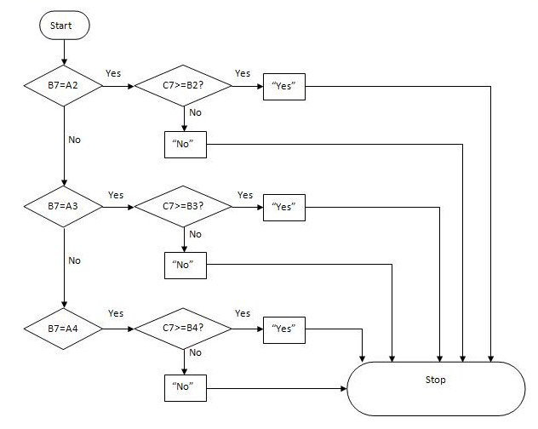
Flow chart

Slide 3
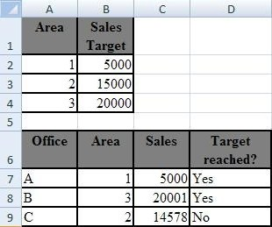
Excel
=IF($A$2=B7;IF($B$2<=C7;"Yes"; "No"); IF($A$3=B7;IF($B$3<=C7;"Yes"; "No"); IF($A$4=B7;IF($B$4<=C7;"Yes"; "No"))))

Slide 4
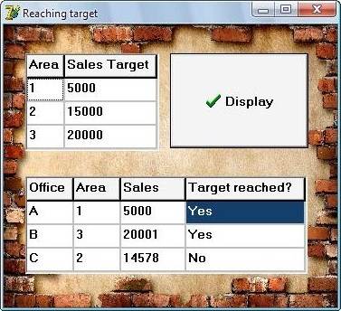
Delphi
with StringGrid1 do
begin
Cells[0, 1]:=IntToStr(a1);
Cells[0, 2]:=IntToStr(b1);
Cells[0, 3]:=IntToStr(c1);
Cells[1, 1]:=IntToStr(x1);
Cells[1, 2]:=IntToStr(y1);
Cells[1, 3]:=IntToStr(z1);
end;
with StringGrid2 do
begin
Cells[1, 1]:=IntToStr(a2);
Cells[2, 1]:=IntToStr(x2);
end;
end;
begin
If a2=a1 then
begin
If x2>=x1 then With StringGrid2 do cells[3, 1]:='Yes' else With StringGrid2 do cells[3, 1]:='No';
end;
If a2=b1 then
begin
If x2>=y1 then With StringGrid2 do cells[3, 1]:='Yes' else With StringGrid2 do cells[3, 1]:='No';
end;
If a2=c1 then
begin
If x2>=z1 then With StringGrid2 do cells[3, 1]:='Yes' else With StringGrid2 do cells[3, 1]:='No';
end;
end.

Slide 5
The advantages/disadvantages of using Excel for this task
Advantages:
Very easy
Short code
You need just to enter the numbers
You can spread the code to other
Only one file
You can copy information
Disadvantages:
You can not open the excel file if there is not Microsoft Office
Everybody can change your excel file

Slide 6
The advantages/disadvantages of using Delphi for this task
Advantages:
You can open the program everywhere (Windows)
Nobody can change your program
You can change style and background
Disadvantages:
Very hard
Too long code
You have to write the code for all cells
A lot of files
You can not copy information

Slide 7
Conclusion
The most suitable application for this task is Excel, because this task is easy and doesn’t need a hard way of programming in Delphi.

Slide 8
Thanks for attention!

